Slide 1

DEPARTMENT OF BUDGET AND MANAGEMENT
DBM UPDATES:
Barangay
Planning-Budgeting
JOHN ARIES S. MACASPAC
Director IV, DBM-SPIB

Slide 2
1
OUTLINE OF PRESENTATION
DBM Mandates
2
Local Planning - Budgeting Framework and Process
3
SK Planning-Budgeting Process

Slide 3

MANDATE
The Department of Budget and Management is responsible for the efficient and sound utilization of government funds and revenues to effectively achieve our country’s development objectives.

Slide 4

FUNCTIONS RELATED TO LGUs
Release Allocations to LGUs through the BTr
Review the annual and supplemental budgets of Provinces and HUCs
Promulgate the Budget Operations Manual to improve and systematize methods, techniques and procedures employed in budget operation, preparation, authorization, review, execution and accountability.

Slide 5

THE
BARANGAY
Role
Smallest political
unit
primary planning and implementing unit of government policies, plans, PPAs in the community
Manner of Creation
Requisites for Creation
Entitlement to IRA/NTA
Law enacted by Congress
Ordinance enacted by the Provincial/City Council
At least 2,000 – outside Metro Manila
At least 5,000 – within Metro Manila
If created by Congress, the barangay is entitled to IRA/NTA

Slide 6
BARANGAY OFFICIALS
Elective Barangays Officials
Appointive Barangays Officials
Punong Barangay and seven (7) members of Sangguniang Barangay
A citizen of the Philippines;
A registered voter in the barangay he intends to be elected;
A resident for at least one (1) year immediately preceding the day of the election;
Able to read and write Filipino or any other local language or dialect; and
Must be at least eighteen (18) years of age on election day.
Barangay Secretary and Barangay Treasurer
Shall be appointed by the Punong Barangay with the concurrence of the majority of all the Sangguniang Barangay members;
Shall be of legal age, a qualified voter, and an actual resident of the barangay concerned; and
No person shall be appointed barangay secretary if he is a Sangguniang Barangay member, a government employee, or a relative of the punong barangay within the fourth civil degree of consanguinity of affinity.

Slide 7
BARANGAY SOURCES OF FUNDS
OTHER LOCAL SOURCES
Sec. 153, 154, 155, 156, 271, RA 7160
SHARES IN THE PROCEEDS OF NATIONAL TAXES
Sec. 284, 285, RA 7160
SHARES FROM NATIONAL WEALTH
Sec. 289, 292, RA 7160
SCOPE OF TAXING POWERS
(Sec. 152, RA 7160)

Slide 8
IRA/NTA SHARE OF LGUs
LGUs shall have a just share, as determined by law, in the national taxes which shall be automatically released to them.
Forty percent (40%) of the share in the national internal revenue taxes (NIRT) based on the collection of the third fiscal year preceding the current fiscal year will be given to LGUs

Slide 9
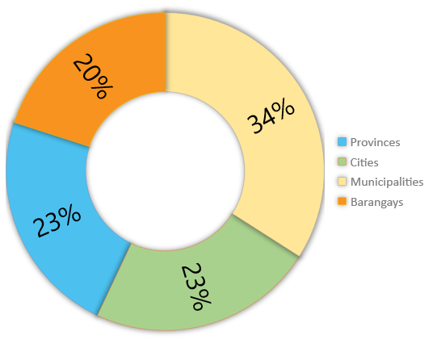
ALLOCATION OF THE NTA PER LGU LEVEL
LEVEL OF LGU | NO. OF LGUs | % ALLOCATION
Provinces | 83¹ | 23%
Cities | 149 | 23%
Municipalities | 1,491 | 34%
Barangays | 41,911 | 20%
Total | 43,634 | 100%
¹ There are only 82 provinces, but the Metro Manila Development Authority receives NTA like that of a province pursuant to Section 10 (b) of RA No. 7924.
NTA ALLOCATION PER LGU LEVEL

Slide 10



IRA/NTA COMPUTATION
PhP 80,000
for each barangay with a population of not less than one hundred (100) inhabitants
Population
50%
Land Area
25%
Equal Sharing
25%
60%
Population
40%
Equal Sharing
Provinces, Cities, and Municipalities
Barangays

Slide 11
IRA/NTA SHARE OF LGUs
USES OF THE FUND
To fund basic services and facilities pursuant to Section 17 of RA No. 7160 particularly those which have been devolved by the National Government; and
To fund development projects as identified in the LGUs Annual Investment Plan.

Slide 12
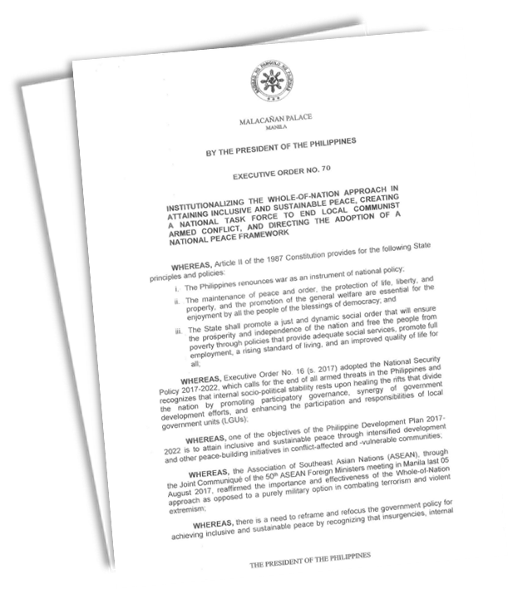
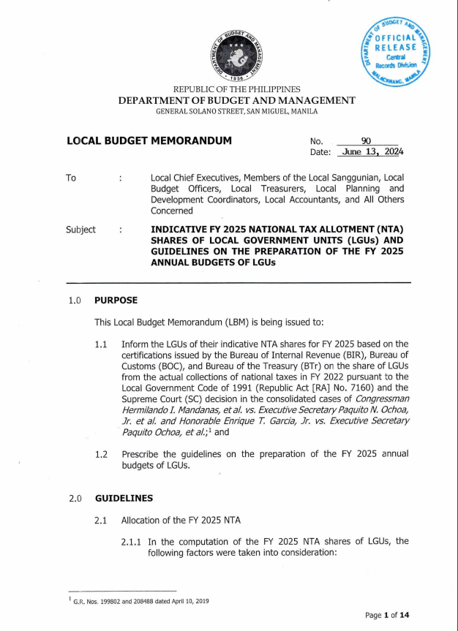
LOCAL BUDGET MEMORANDUM NO. 90, AS AMENDED
FY 2025 NATIONAL TAX ALLOTMENT SHARES OF LOCAL GOVERNMENT UNITS AND GUIDELINES ON THE PREPARATION OF THE FY 2025 ANNUAL BUDGETS OF LGUS

Slide 13
FY 2025 NTA OF LGUs
Certification | Amount (Php)
 | FY 2024 | FY 2025
Bureau of Internal Revenue | 687,998,360,000 | 776,559,602,000
Bureau of Customs | 183,357236,000 | 258,003,912,000
Bureau of the Treasury | 19,603,000 | 41,355,000
TOTAL | 871,375,199,000 | 1,034,604,869,000

Slide 14
ALLOCATION OF THE NTA PER LGU LEVEL
LEVEL OF LGU | NO. OF LGUs | % ALLOCATION | TOTAL NTA SHARES
Provinces | 83¹ | 23% | 237,959,119,870
Cities | 149 | 23% | 239,045,960,732
Municipalities | 1,491 | 34% | 350,678,814,598
Barangays | 41,911 | 20% | 206,920,973,800
Total | 43,634 | 100% | 1,034,604,869,000

Slide 15
CHANGES IN THE FY 2025 INDICATIVE NTA
Pursuant to Section 95 of the General Provisions of the FY 2024 GAA, RA No. 11975, all valid adjustments, changes, modifications, or alterations in any of the factors affecting the computation of the NTA that occurred or happened, including final and executory court decisions made effective, during the current fiscal year (FY 2024), shall only be considered and implemented by the DBM in the subsequent fiscal year (FY 2025) from receipt by the DBM of the notice of the said change.

Slide 16
SHARES IN THE UTILIZATION AND
DEVELOPMENT OF NATIONAL WEALTH
Types of National Wealth and the authorized collecting agencies:
40%
gross collection derived by the NG from the utilization and development of national wealth
Particulars | Collecting Agency
Forest Charges | Department of Environment and Natural Resources (DENR)
Royalty Income from Mineral Reservation | DENR-Mines and Geo-Sciences Bureau (MGB)
Energy Resources Production | Department of Energy (DOE)
Mining Taxes | Bureau of Internal Revenue (BIR)

Slide 17
DISTRIBUTION OF SHARES IN THE UTILIZATION
AND DEVELOPMENT OF NATIONAL WEALTH
Natural Resources are located in the Province
Province | 20%
Component City or Municipality | 45%
Barangay | 35%
Natural Resources are Located in a HUC or ICC
City | 65%
Barangay | 35%
Natural Resources are Located in 2 or more LGUs
Population | 70%
Land Area | 30%

Slide 18
SHARES IN THE UTILIZATION AND DEVELOPMENT OF NATIONAL WEALTH
USES OF THE FUND
To finance local development and livelihood projects of recipient LGUs.
In the case of energy resources, at least 80% of proceeds derived from the development and utilization of hydro-thermal, geothermal and other sources of energy, shall be applied solely to lower the cost of electricity in the LGU where the source of energy is located.

Slide 19
PROCESS OF INTER-GOVERNMENTAL TRANSFERS
Revenue Collecting Agency |  | DBM |  | BTr
Prepares Joint Certification of Actual Collections and submits to BTr |  |  |  | Reviews and Approves Joint Certification
 |  | CO: Computes the Allocation per LGU and prepares SARO and NCA |  | Submits Joint Certification to DBM
 |  |  |  | Issues ADA to GSBs
 |  |  |  | Issues NADAI to LGUs

Slide 20
LOCAL BUDGETING FRAMEWORK
Process and Significance to Sustainable Local Development

Slide 21

BUDGETING
Spending within our means
Investing in the right priorities
Delivering measurable results
Empowering citizens through fiscal transparency, accountability,
and participation

Slide 22

LOCAL BUDGETING FRAMEWORK
within our means
PARTICIPATORY
invests in the right priorities
delivers measurable results
POLICY-BASED
PERFORMANCE-INFORMED
empowers citizens

Slide 23
BARANGAY PLANNING
AND BUDGETING PROCESS
Process and Significance to Sustainable Local Development

Slide 24

BARANGAY PLANNING PROCESS
“As the basic political unit, the barangay serves as the primary planning and implementing unit of government policies, plans, programs, projects, and activities in the community, and as a forum wherein the collective views of the people may be expressed, crystallized and considered, and where disputes may be amicably settled”
- Section 384 (b), R.A. No. 7160

Slide 25
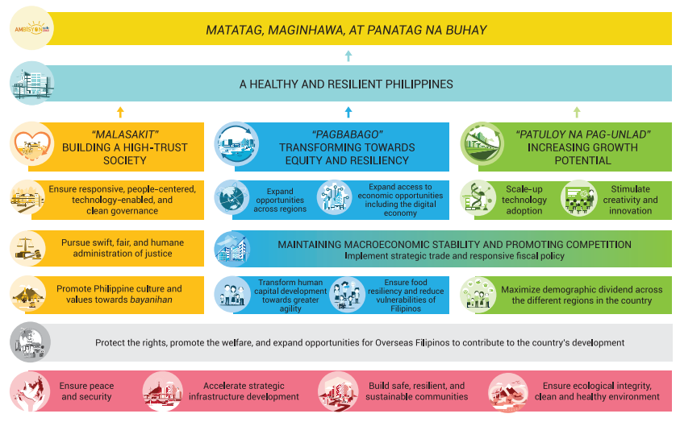


LEGAL BASIS
Local budget plans and goals shall be harmonized with national development plans, goals, and strategies
- Section 305 (h) of RA No. 7160
LGUs are enjoined to align their PPAs with the priorities of the National Government, specifically those embodied under the updated Philippine Development Plan for 2013-2028.
The PPAs of LGUs shall have a results-oriented focus on national development goals and shall be in line with AMBISYON NATIN 2040, the 2030 Agenda for Sustainable Development, and the President's 8-Point Socio-Economic Agenda.

Slide 26
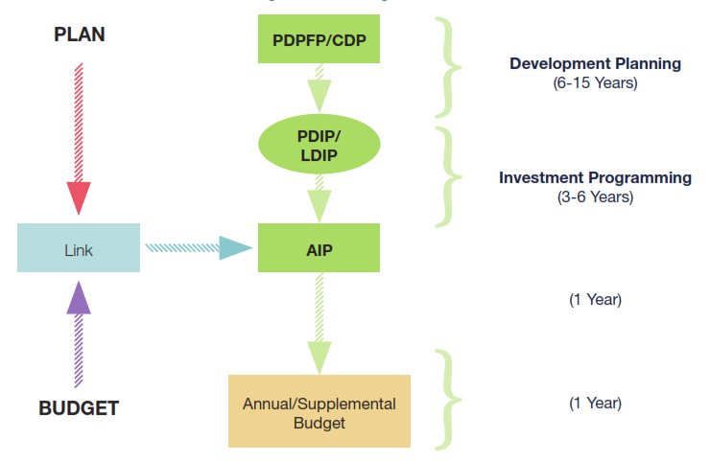
LINKING HARMONIZED PLANS AND POLICIES TO THE BUDGET

Slide 27
BARANGAY PLANNING
BARANGAY DEVELOPMENT PLAN
(6 YEARS)
Article 410, IRR, R.A. No. 7160, mandates three (3) important points relative to the relationship between the barangay development plan and barangay budget, as follows:
The barangay development plan and Annual Investment Program (AIP) shall be prepared and approved during the fiscal year before the calendar for budget preparation;
The AIP shall specify projects for inclusion in the barangay budget as well as in the budget of NGAs and GOCCs; and
The plan shall be used to ensure that the projects proposed for local funding are included in the barangay budget.
BARANGAY DEVELOPMENT
INVESTMENT PROGRAM
(3 YEARS)
ANNUAL INVESTMENT PROGRAM
(1 YEAR)

Slide 28

BARANGAY PLANNING
The Barangay Development Council (BDC) shall prepare the barangay development plan and shall assist the sanggunian in setting the direction of economic and social development, and coordinating development efforts within its territorial jurisdiction.
Composition:
Punong Barangay – Head
Members of the sangguniang barangay
Representatives of non-governmental organizations operating in the barangay, who shall constitute not less than one fourth (1/4) of the members of the fully organized council
A representative of the congressman

Slide 29
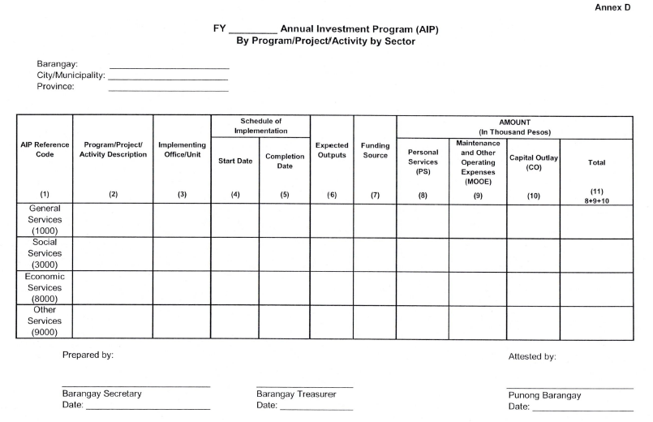

Slide 30
BARANGAY
BUDGETING PROCESS

Slide 31

WHAT IS BUDGET?
“A financial plan embodying the estimates of income and expenditures for a given period of time
(usually for one fiscal year).”
“
- Section 306 (a), R.A. No. 7160

Slide 32
WHAT IS AN APPROPRIATION ORDINANCE?
“A legislative action authorizing the payment of goods and services from local government funds under specified conditions or
for specific purposes.”
“
- Section 306 (b), R.A. No. 7160

Slide 33




FUNCTIONS OF BUDGETING
CONTROL
ACCOUNTABILITY
To ascertain that programs have attained their targets.
To limit expenditures
PLANNING
DEVELOPMENT
To ensure that what is implemented is part of the plan.
To drive development.

Slide 34

BUDGETING AS A FUNCTION…
pushes, strengthens and bridges
the interconnection of the
different elements of
Public Financial Management

Slide 35
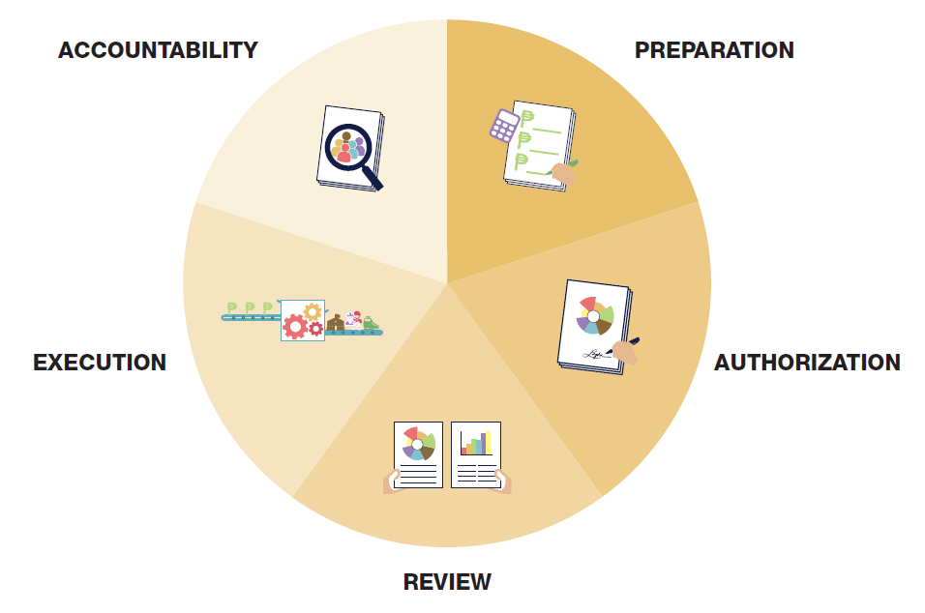
THE LOCAL
BUDGET PROCESS
AUTHORIZATION
EXECUTION

Slide 36

BUDGET PREPARATION
“Upon receipt of the statement of income and expenditures from the barangay treasurer, the punong barangay shall prepare the barangay budget for the ensuing fiscal year in the manner and within the period prescribed in this Title and submit the annual budget to the sannguniang barangay for legislative enactment.”
Section 331 (a), R.A. No. 7160

Slide 37
BUDGET PREPARATION
“In coordination with the barangay development council, the punong barangay shall prepare the annual executive and supplemental budgets of the barangay.”
Section 331 (a), R.A. No. 7160
“Changes in the annual budget may be done through supplemental budgets.”
Article 417, IRR, R.A. No. 7160

Slide 38



KEY PLAYERS
Barangay
Development Council
Punong Barangay
Barangay Treasurer

Slide 39
STEPS IN PREPARING THE ANNUAL BUDGET
Step 1 . Barangay Treasurer submits the detailed Statement of Income and Expenditure.
On or before September 5 – The city or municipal treasurer (together with the city or municipal accountant), shall issue a certified statement covering the actual income of the past year and estimates of income of the current and ensuing fiscal years from local sources for the barangay concerned.
On or before September 15 – The treasurer shall submit to the punong barangay a statement covering the estimates of income and expenditures for the past, current, and the ensuing fiscal years.
Article 423 (b), IRR of R.A. No. 7160

Slide 40
Step 2. The Punong Barangay in coordination with the BDC prepares the barangay budget.
STEPS IN PREPARING THE ANNUAL BUDGET
Section 389 (b) (7), R.A. No. 7160
Task 1. The Punong barangay prepares the estimated income for the ensuing year upon receipt of the statement of income and expenditure from the barangay treasurer.
Task 2. Of the total general fund (estimated income), set aside 10% for the Sangguniang Kabataan and inform the SK Chairperson, as soon as possible, of the total amount representing the 10% SK fund.
Section 329, R.A. No. 7160

Slide 41
Step 2. The Punong Barangay in coordination with the BDC prepares the barangay budget.
STEPS IN PREPARING THE ANNUAL BUDGET
Section 389 (b) (7), R.A. No. 7160
Task 3. Provide for budgetary requirements or Mandatory Allocations
Payment of debts – must not exceed 20% of the regular income of the barangay.
BDRRMF set aside not less than five percent (5%) of estimated revenue from regular sources.

Slide 42
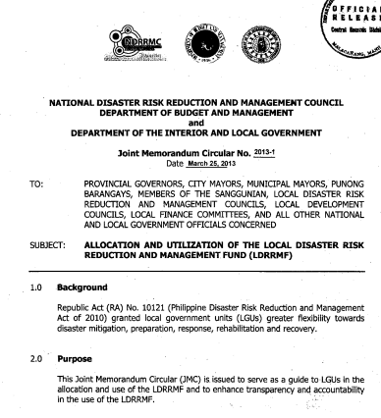
NDRRMC-DBM-DILG JOINT MEMORANDUM CIRCULAR NO. 2013-1 DATED MARCH 25, 2013
GUIDELINES ON THE ALLOCATION AND UTILIZATION OF THE LOCAL DISASTER RISK REDUCTION AND MANAGEMENT FUND

Slide 43
ALLOCATION FOR THE LDRRMF
LDRRMF amounting to not less than five percent (5%) of the estimated revenue from regular sources shall be set aside to support disaster risk management activities.
30%
70%
Quick Response Fund (QRF)
  Disaster prevention and mitigation, preparedness, response, rehabilitation and recovery

Slide 44




UTILIZATION OF THE LDRRMF
Disaster Prevention and Mitigation
Disaster Preparedness
Disaster Response
Disaster Rehabilitation and Recovery

Slide 45
Step 2. The Punong Barangay in coordination with the BDC prepares the barangay budget.
STEPS IN PREPARING THE ANNUAL BUDGET
Section 389 (b) (7), R.A. No. 7160
Task 3. Provide for budgetary requirements or Mandatory Allocations
Statutory and other contractual obligations
20% of IRA for development projects shall be utilized in accordance with DILG-DBM Joint Memorandum Circular No. 2020-1 dated November 4, 2020

Slide 46
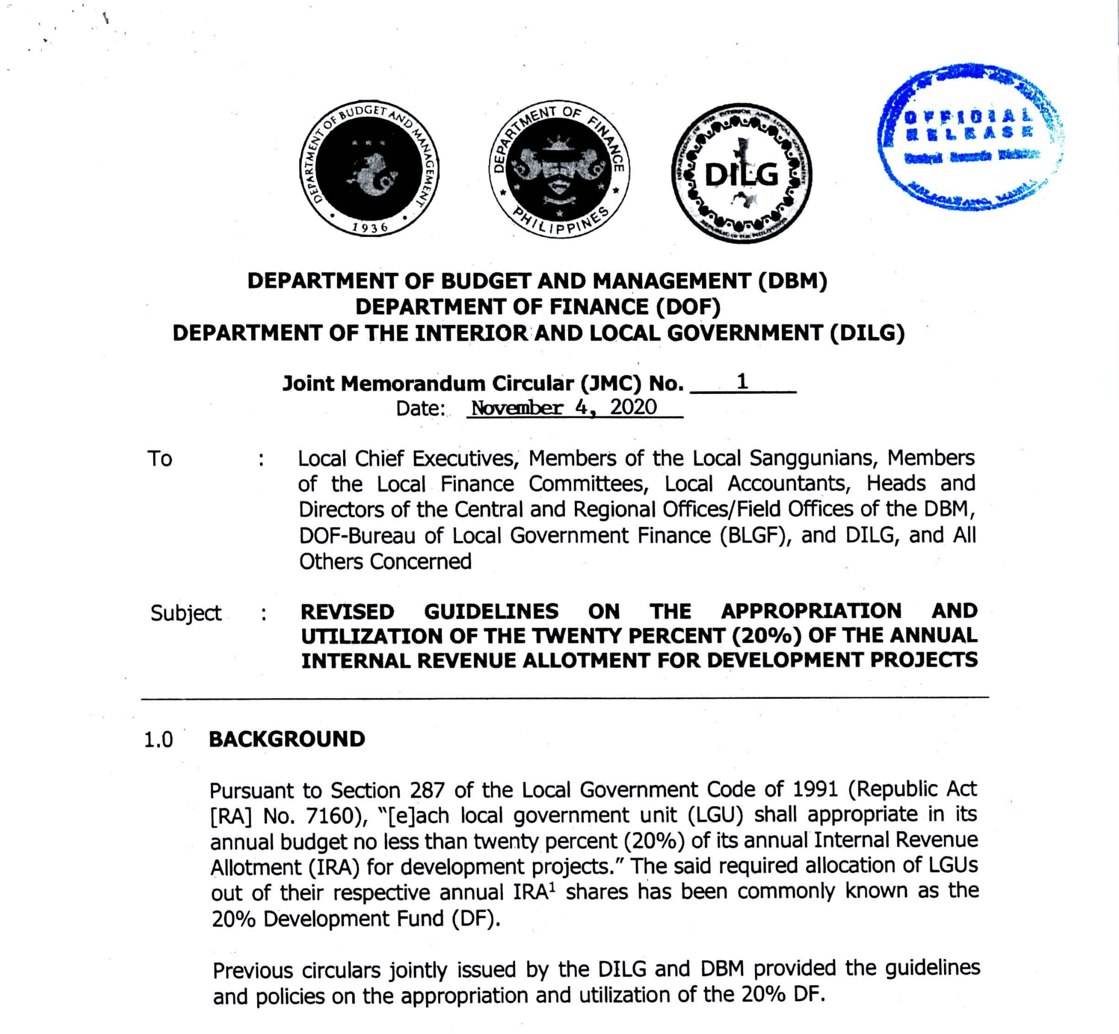
DBM-DOF-DILG JOINT MEMORANDUM CIRCULAR DATED NOVEMBER 4, 2020
REVISED GUIDELINES ON THE APPROPRIATION AND UTILIZATION OF THE 20% OF THE ANNUAL INTERNAL REVENUE ALLOTMENT FOR DEVELOPMENT PROJECTS

Slide 47
GENERAL GUIDELINES
The LGUs shall ensure that the development projects are well planned and procurement and implementation ready.
01
The 20% DF shall be utilized to finance the LGUs' priority development projects.
03
The development projects that may be included under the 20% DF shall be necessary, appropriate, or incidental to efficient and effective local governance, and essential to the promotion of the general welfare of the people.
Technical assistance may be sought from NGAs for the determination of the more relevant and responsive development projects and to ensure compliance with the standards prescribed by the NGAs concerned.
02
04

Slide 48
GENERAL GUIDELINES
The following expenditure items shall not be allowed to be charged against the 20% DF:
Personal Services expenditures;
Administrative expenses;
Traveling expenses;
Registration fees and other expenses related to the conduct of and participation to trainings, seminars, conferences or conventions;
Purchase, maintenance or repair of administrative office' furniture, fixtures, equipment or appliances; and
Purchase, maintenance or repair of motor vehicles used for administrative purposes.

Slide 49
Step 2. The Punong Barangay in coordination with the BDC prepares the barangay budget.
STEPS IN PREPARING THE ANNUAL BUDGET
Section 389 (b) (7), R.A. No. 7160
Task 4. Compute the mandatory requirements for PS, MOOE, and CO.
Total PS requirement for 1 fiscal year shall not exceed 55% of the total annual income realized from local sources during the next preceding fiscal year.
Essential expenditures shall be given priority in the allocation of funds.
Any available fund or resource of LGUs shall first be allocated for the provision of basic services and facilities before using such fund or resource for other purposes, unless otherwise provided in the Code.

Slide 50
BASIC SERVICES AND FACILITIES INCLUDE, BUT ARE NOT LIMITED TO, THE FOLLOWING:
Agricultural support services
Health and social welfare services;
Services and facilities related to general hygiene and sanitation, beautification, and solid waste collection;
Maintenance of Katarungang Pambarangay;
Maintenance of Barangay roads and bridges and water supply systems;
Infrastructure facilities
Information and reading center; and
Satellite or public market

Slide 51
Step 2. The Punong Barangay in coordination with the BDC prepares the barangay budget.
STEPS IN PREPARING THE ANNUAL BUDGET
Section 389 (b) (7), R.A. No. 7160
Task 4. Compute the mandatory requirements for PS, MOOE, and CO.
Task 5. Consolidates the estimated income and the proposed expenditures into:
Part 1 – Receipts Program
Part 2 – Expenditure Program

Slide 52
Step 2. The Punong Barangay in coordination with the BDC prepares the barangay budget.
STEPS IN PREPARING THE ANNUAL BUDGET
Section 389 (b) (7), R.A. No. 7160
Task 4. Compute the mandatory requirements for PS, MOOE, and CO.
Task 5. Consolidates the estimated income and the proposed expenditures
Task 6. Prepares the APP using the prescribed format.
Task 7. Prepares the Budget message.

Slide 53
STEPS IN PREPARING THE ANNUAL BUDGET
Step 3. Punong Barangay submits the proposed Annual Budget to the sangguniang barangay not later than October 16 of the current fiscal year.
Section 318, R.A. No. 7160
Budget Message
Plantilla of Personnel
Approved AIP
Annual Procurement Plan
List of Projects chargeable against the 20% development fund
DILG-endorsed GAP Plan and Budget
Statement of Indebtedness (if any)

Slide 54
BARANGAY BUDGET PREPARATION (BBP) FORMS
BBP Form No. 1 | Budget of Expenditures and Sources of Financing
BBP Form No. 2 | Programmed Appropriation by PPA, Expense Class, Object of Expenditure and Expected Results
BBP Form No. 2-A | List of Projects Chargeable Against the 20% Development Fund
BBP Form No. 3 | Plantilla of personnel
BBP Form No. 4 | Statement of Indebtedness

Slide 55

BUDGET AUTHORIZATION
“No money shall be paid out of the local treasury except in pursuance of an appropriations ordinance or law.”
Section 305 [a], RA No. 7160
“The Sangguniang Barangay shall enact annual and supplemental budgets in accordance with the provisions of the Code”
Section 391 (a) (3), R.A. No. 7160

Slide 56
BUDGET AUTHORIZATION
not later than October 16 of the current ﬁscal year

Slide 57
LIABILITY FOR FAILURE TO SUBMIT AN EXECUTIVE BUDGET
Failure to submit the budget within the prescribed period –
Subjects LCE to criminal and administrative penalties provided under the Code and other applicable laws
[Section 318, RA No. 7160]
Sec. 60 – Grounds for disciplinary actions
(Secs. 61-68 – other rules on disciplinary actions)
Villanueva vs. Ople, GR. 165125, Nov. 18, 2005
70

Slide 58
LEGISLATIVE AUTHORIZATION OF THE BUDGET
“On or before the end of the current ﬁscal year, the Sanggunian concerned shall enact, through an ordinance, the annual budget of the local government unit for the ensuing ﬁscal year on the basis of the estimates of income and expenditures submitted by the local chief executive.”
Section 319, RA No. 7160

Slide 59
HOW THE BARANGAY BUDGET IS AUTHORIZED?
Step 1: Present the Executive Barangay Budget to the Sangguniang Barangay.
Deliver the State of the Barangay Address (SOBA)
Follow Contents of Budget Message
Certify as urgent the proposed executive budget
72

Slide 60
HOW THE BARANGAY BUDGET IS AUTHORIZED?
Step 1: Present the Executive Barangay Budget to the Sangguniang Barangay.
Step 2: Deliberate on the Executive Budget
Discuss the allocation of income to the budgetary requirements;
Discuss the allocation of income to other Priority Projects, Activities and Purposes
Discuss Sources of Income
73

Slide 61
HOW THE BARANGAY BUDGET IS AUTHORIZED?
Step 3: Enact the General Appropriations Ordinance (GAO)
Effectivity of a General Appropriations Ordinance - beginning of the budget year
Period of Approval
  If SB fails to enact the ordinance on time - the SB shall continue to hold sessions without additional remuneration until the ordinance is approved and no other business may be taken up during such sessions.
74

Slide 62
HOW THE BARANGAY BUDGET IS AUTHORIZED?
Step 3: Enact the General Appropriations Ordinance (GAO)
Effectivity of a General Appropriations Ordinance - beginning of the budget year
Period of Approval
  If the SB fails to pass the budget - The ordinance authorizing the appropriations of the past year shall be deemed reenacted.
75

Slide 63
HOW THE BARANGAY BUDGET IS AUTHORIZED?
Step 3: Enact the General Appropriations Ordinance (GAO)
Reduction/Increase of Appropriations by the SB
Vote of the Punong Barangay on the Proposed Budget
  The PB may vote against the appropriations ordinance if important items in his original proposal are not adopted substantially or there are unnecessary insertions or deletions.
76

Slide 64
HOW THE BARANGAY BUDGET IS AUTHORIZED?
Step 3: Enact the General Appropriations Ordinance (GAO)
Step 4: Approval of the GAO by the Punong Barangay
The ordinance enacted by the SB, upon approval by the majority of its members, need to be approved and signed by the PB.
The PB does not have a veto power since he is also the presiding chairman of the SB.

Slide 65
BUDGET REVIEW
“Within 10 days from its approval, copies of the barangay ordinance authorizing the annual appropriations shall be furnished the sangguniang panlungsod or sangguniang bayan, as the case may be, through the city or municipal budget ofﬁcer.
The sanggunian concerned shall have the power to review such ordinance in order to ensure that the provisions of this Title (Title Five – Local Fiscal Administration) are complied with.”
Section 333, RA No. 7160

Slide 66
BUDGET REVIEW
“Within 10 days after its enactment, the sangguniang barangay shall furnish copies of all barangay ordinances to the sangguniang
panlungsod or sangguniang bayan concerned for review as to whether the ordinance is consistent with law and city or municipal ordinances.”
Section 57, RA No. 7160; Article 111, IRR
“The sanggunian concerned shall review the barangay ordinance to ensure compliance thereof with all the budgetary requirements and limitations
provided in this Rule (Rule XXXIV – Local Government Budgeting).”
Article 424 (b), IRR

Slide 67
HOW IS BUDGET REVIEW DONE?
Step 1: Review within 60 days upon receipt.
If the Sangguniang Panglungsod/Bayan fails to review the barangay budget within the 60-day period the budget is deemed in full force and effect.
80

Slide 68
HOW IS BUDGET REVIEW DONE?
Step 1: Review within 60 days upon receipt.
Step 2: Check consistency of GAO with AIP and ELA and existing laws
Step 3: Declare the Review Actions.
Declare the Barangay Budget Operative
Declare the barangay budget inoperative in its entirety
Declare the barangay budget inoperative in part
81

Slide 69
HOW IS BUDGET REVIEW DONE?
Step 1: Review within 60 days upon receipt.
Step 2: Check consistency of GAO with AIP and ELA and existing laws
Step 3: Declare the Review Actions.
Step 4: Appeal for reconsideration in case of Conflict in Budget Review
82

Slide 70
BUDGET EXECUTION
“The ordinance enacting the annual budget shall take effect at the beginning of the ensuing calendar year. An ordinance enacting a supplemental budget, however, shall take effect upon its approval or on the date ﬁxed herein.”
“The Punong Barangay shall be primarily responsible for the execution… of the annual and supplemental budgets of the barangay.
Section 332, RA No. 7160

Slide 71






KEY PLAYERS
Chairman, Committee on Appropriations
Punong Barangay
Barangay Treasurer
City/Municipal Accountant

Slide 72
BUDGET EXECUTION
APPROPRIATION
  An authorization made by ordinance, directing the payment of goods and services from local government funds under specified conditions or purposes.
ALLOTMENT
  The authorization issued by the Local chief Executive (LCE) to a Department / Office of the LGU which allows it to incur obligations for specified amounts within its appropriations.
OBLIGATION
  The specific amount within the allotment which is committed to be paid by the LGU for any lawful expenditure made by an accountable officer for and in behalf of the LGU concerned.

Slide 73
BUDGET ACCOUNTABILITY
The responsibility for the execution of the annual and supplemental budgets and the accountability shall be vested primarily in the LCE.
Fiscal responsibility shall be shared by all those exercising authority over the financial affairs, transactions, and operations of the LGUs.
Section 332 (a), R.A. No. 7160
- Sections 320, RA No. 7160
- Section 305 (I) , R.A. No. 7160

Slide 74
01
Record all collections from taxes, fees, charges and contributions due or accruing to the barangay in the Income Books of Account under the General Fund.
02
Issue an official receipt for all taxes, fees, charges and contribution collected.
BUDGET
ACCOUNTABILITY
03
Deposit all collections in the depository account maintained in the name of the barangay within five (5) days after receipt.
04
Collect Real Property Taxes and such other taxes as may be imposed by province/city/municipality that are due in the barangay
05
Record all obligations and disbursements in the Expenditure Books of Accounts under the General Fund.

Slide 75
06
Segregate all expenditure levels by sector.
07
Post in a conspicuous place in the Barangay the income earned for the quarter and where it was spent.
BUDGET
ACCOUNTABILITY
08
Post in a conspicuous place the three (3) Barangay Budget Accountability Forms No. 1 to 3.
09
Monitor and evaluate performance
Monitor actual results of service delivery and implementation of development projects.
Compare actual results with planned targets.
Provide corrective actions for negative deviations.

Slide 76
Thank you!
For more information:
Department of Budget and Management
General Solano Street, San Miguel, Malacañang, Manila
Trunkline: (02) 8657-3300 local 2345
Website: www.dbm.gov.ph

Slide 77
SANGGUNIANG KABATAAN PLANNING AND BUDGETING
DEPARTMENT OF BUDGET AND MANAGEMENT
DIRECTOR JOHN ARIES S. MACASPAC
Systems and Productivity Improvement Bureau
Department of Budget and Management

Slide 78



GUIDELINES ON THE
APPROPRIATION, RELEASE, PLANNING AND BUDGETING PROCESS FOR THE
SANGGUNIANG KABATAAN FUNDS
DEPARTMENT OF BUDGET AND MANAGEMENT (DBM)
DEPARTMENT OF THE INTERIOR AND LOCAL GOVERNMENT (DILG)
NATIONAL YOUTH COMMISSION (NYC)
Joint Memorandum Circular No. 1 dated January 23, 2019

Slide 79
LEGAL BASIS
Ten percent (10%) of the general fund of the barangay shall be set aside for the SK. The sangguniang barangay shall appropriate the SK funds in lump-sum, which shall be disbursed solely for youth development and empowerment purposes.
Section 20 (a) of RA No. 10742
The Sangguniang Kabataan shall have financial independence in its operations, disbursements and encashment of their fund, income and expenditures.
Section 20 (b) of RA No. 10742

Slide 80
APPROPRIATION OF THE SK FUND BY THE BARANGAY
The punong barangay shall include the 10% of the general fund accruing to the SK in the barangay executive budget to be submitted to the sangguniang barangay for budget authorization purposes.
03
The barangay treasurer shall inform, in writing, the SK chairperson and the SK treasurer on or before the 15th day of September of the estimated 10% of the general fund of the barangay for the ensuing fiscal year, supported by a certification of income of the barangay from the city/municipal treasurer.
01
02
The sangguniang barangay shall appropriate the said SK funds in lump-sum in the pertinent appropriation ordinance.

Slide 81
RELEASE OF THE SK FUND BY THE BARANGAY
The SK funds shall be deposited by the barangay in the current account of the SK not later than 5 working days after the crediting of the monthly NTA share of the barangay.
01
The SK funds shall be automatically released by the barangay to the SK, and shall not be subject to any lien or holdback.
03
The SK shall open a current account in the name of the SK in a bank, situated in or nearest to its area of jurisdiction, with the SK chairperson and the SK treasurer as the official signatories.
For all other income accruing to the general fund of the barangay, the corresponding SK funds shall be deposited not later than 5 working days after the end of the month.
02
04

Slide 82
RELEASE OF THE SK FUND BY THE BARANGAY
In case of barangays without elected SK officials, the barangay shall transfer the corresponding 10% SK Fund to the trust fund of the barangay, and the same shall be released by the barangay upon the election of the SK officials concerned.
05
The barangay may opt to transfer/release the SK funds earlier than prescribed on an annual, semestral or quarterly basis.
07
Failure by the barangay to release any amount of the SK fund shall subject the erring officials to penalties under existing laws.
06

Slide 83
PLANNING AND BUDGETING PROCESS FOR THE SK FUND

Slide 84
PLANNING PROCESS BY THE SK
03
The ABYIP shall be prepared and approved by the SK through a resolution before the start of the preparation of the SK annual budget.
01
The SK, in consultation with the Katipunan ng Kabataan, shall formulate a 3-year rolling plan.
02
The CBYDP shall serve as the basis for the preparation of the ABYIP, which shall contain the specific PPAs with corresponding project costs.
04
In the preparation of the CBYDP and ABYIP, the SK shall observe the pertinent policies and guidelines issued by the NYC for the purpose.

Slide 85
BUDGET PREPARATION BY THE SK
The SK annual budget, which is the financial plan embodying the estimates of the income and expenditures of the SK for one fiscal year, shall be prepared in accordance with the approved ABYIP.
Priority should be given to youth development and empowerment PPAs in accordance with the Philippine Youth Development Plan and Local Youth Development Plan, as embodied in the approved CBYDP and ABYIP, that will promote the following:
Equitable access to quality education;
Environmental protection;
Climate change adaptation;
Disaster risk reduction and resiliency;
Youth employment and livelihood;
Health and antidrug abuse;
Gender sensitivity;
Sports development; and
Capability Building, which emphasizes leadership training.
01
03
02
The SK chairperson, with the assistance of the SK treasurer, shall prepare the SK annual budget consisting the estimates of income and expenditure program.

Slide 86
BUDGET PREPARATION BY THE SK
All regular operating expenses pertaining to the activities of the SK shall be charged against the SK funds, subject to the applicable budgeting, accounting, and auditing laws, rules and regulations.
The SK chairperson shall submit the proposed SK annual budget to the SK members not later than the 16th day of October of the current year for budget authorization purposes.
04
06
The conduct of study tours of the SK officials, chargeable against the SK fund, shall be subject to the policies and guidelines prescribed under DILG-DBM JMC No. 2 dated September 23, 2016.
05

Slide 87
BUDGET AUTHORIZATION BY THE SK
The SK shall pass a resolution approving the SK AB/SB. For the annual budget, the resolution shall be passed before the beginning of the ensuing year.
The SK secretary shall post the resolution approving the SK AB/SB in the barangay bulletin board, and in at least 3 conspicuous places within the jurisdiction of the barangay.
01
03
All budgetary items shall be included and considered in the preparation of the AB. However, if funds allow, changes in the AB may be done through SBs under the following circumstances:
When supported by funds actually available as certified by the SK treasurer; and
If covered by new revenue source(s).
The SK secretary shall submit the SK AB/SB to the sangguniang panlungsod or sangguniang bayan, through the city/municipal budget officer, within 10 days upon the approval thereof.
02
04

Slide 88
BUDGET REVIEW BY THE SANGGUNIANG PANLUNGSOD
OR SANGGUNIANG BAYAN
The reviewing authority shall within 60 days upon receipt review the SK AB/SB on their compliance with the priority PPAs identified under Section 20 (c) of RA No. 10742, and with other existing laws, rules and regulations.
01
02
Depending on its findings, the sangguniang panlungsod or sangguniang bayan may render the following review actions.

Slide 89
REVIEW ACTIONS
OPERATIVE IN ITS ENTIRETY
INOPERATIVE IN ITS ENTIRETY
01
03
OPERATIVE IN ITS ENTIRETY, SUBJECT TO CONDITIONS
02
04
INOPERATIVE IN PART

Slide 90
BUDGET REVIEW BY THE SANGGUNIANG PANLUNGSOD
OR SANGGUNIANG BAYAN
The reviewing authority shall within 60 days upon receipt review the SK AB/SB on their compliance with the priority PPAs identified under Section 20 (c) of RA No. 10742, and with other existing laws, rules and regulations.
Failure on the part of the reviewing authority to complete the review within the prescribed period shall render the said SK AB/SB deemed approved.
01
03
The reviewing authority shall return to the SK chairperson, through the city/municipal budget officer, the SK AB/SB with the advice of action thereon, if any, for proper adjustments.
02
Depending on its findings, the sangguniang panlungsod or sangguniang bayan may render the following review actions.
04

Slide 91
BUDGET EXECUTION BY THE SK
The SK treasurer, whenever necessary, shall certify the availability of funds.
Disbursements shall be made by issuing checks drawn against the current account in the name of the SK with the SK chairperson and SK treasurer as the official signatories.
01
03
02
All payments out of the SK fund shall be made through Disbursement Vouchers.
04
All claims against the SK funds shall be properly supported with complete documentation.

Slide 92
BUDGET EXECUTION BY THE SK
The SK chairperson and SK treasurer shall be properly bonded, chargeable against the SK funds, subject to the pertinent guidelines and policies issued by the Bureau of the Treasury.
However, unexpended balances for capital outlays shall continue and remain valid until fully spent, reverted, or the project is completed.
05
07
The balances for capital outlays shall be reviewed as part of the annual budget preparation and the SK may approve, upon recommendation of the SK chairman, the reversion of funds no longer needed in connection with the activities funded by said balances.
Unexpended balances in the SK budget(s) shall revert to the general fund of the SK at the end of the fiscal year, and shall not thereafter be available for expenditure except by subsequent approval of the SK.
06
08

Slide 93
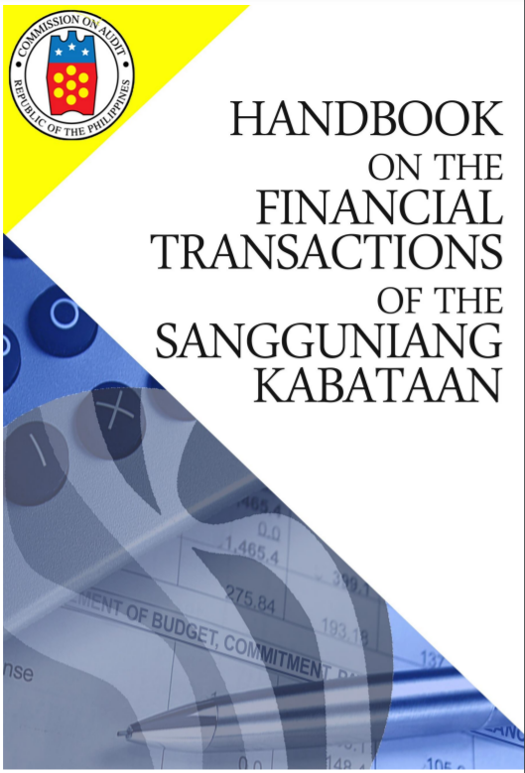
BUDGET ACCOUNTABILITY BY THE SK
The SK chairperson, with the assistance of the SK treasurer and SK secretary, shall prepare the budget accountability reports as may be prescribed by the COA.
The Handbook on the Financial Transactions of the SK covers the accounting policies, guidelines, financial reports and forms to be used in the SK operations.

Slide 94
RESPONSIBILITY AND ACCOUNTABILITY
The responsibility and accountability in the utilization and disbursement of SK funds shall rest upon the SK officials concerned.
It is also the responsibility of the said SK officials to ensure that the SK funds are utilized strictly in accordance with applicable budgeting, accounting, and auditing rules and regulations, and the provisions of the Government Procurement Reform Act (RA No. 9184) and other pertinent laws.

Slide 95
AN ACT STRENGTHENING THE SANGGUNIANG KABATAAN, INSTITUTIONALIZING ADDITIONAL REFORMS TO REVITALIZE YOUTH PARTICIPATION IN LOCAL GOVERNANCE AND BY PROVIDING HONORARIUM, OTHER BENEFITS, AND PRIVILEGES, AMENDING FOR THE PURPOSE CERTAIN SECTIONS OF REPUBLIC ACT NO. 10742, OTHERWISE KNOWN AS THE “SANGGUNIANG KABATAAN REFORM ACT OF 2015”
REPUBLIC ACT NO. 11768

Slide 96
SALIENT FEATURES OF REPUBLIC ACT NO. 11768
18 to 30
Expands eligibility for Sangguniang Kabataan Treasurer and Secretary
25%
SK funds can be allocated for personnel services
Additional honorarium, social welfare contributions, and hazard pay
15%
set aside an amount for mandatory and continuing training
1%
Allows appropriation of LGU budget for LYDO
Age
not more than
not more than
not less than

Slide 97
PRIORITY PROGRAMS, PROJECTS, AND ACTIVITIES
Both the CBYDP and ABYIP shall give priority to PPAs that will promote and attain the thrusts of the PYDP such as:
  Health;
  Education;
  Environment;
  Global mobility;
  Active citizenship;
  Governance;
  Social equity and inclusion;
  Peace-building and security;
  Human rights;
  Gender equality; and
  Economic empowerment.

Slide 98
PRIORITY PROGRAMS, PROJECTS, AND ACTIVITIES
01
Student stipends, food, book and transportation allowances
05
Environmental protection and conservation efforts
Capacity-building for grassroots organization and leadership, and values education
02
Sports and wellness projects
06
Skills training, summer employment, on-the-job training, and livelihood assistance
Programs that address context-specific and intersectional vulnerabilities of young people
03
07
04
Agricultural, fishery, and forestry enterprises

Slide 99
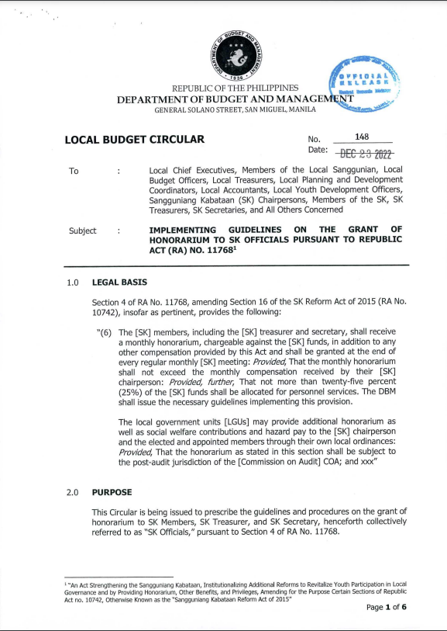
LOCAL BUDGET CIRCULAR NO. 148 DATED DECEMBER 23, 2022
IMPLEMENTING GUIDELINES ON THE GRANT OF HONORARIUM TO SANGGUNIANG KABATAAN OFFICIALS PURSUANT TO REPUBLIC ACT NO. 11768
Published in The Philippine Star on 29 December 2022

Slide 100
LEGAL BASIS
Section 4 of RA No. 11768, amending Section 16 of the SK Reform Act of 2015 (RA No. 10742), provides the following:
“(6) The [SK] members, including the [SK] treasurer and secretary, shall receive a monthly honorarium, chargeable against the [SK] funds, in addition to any other compensation provided by this Act and shall be granted at the end of every regular monthly [SK] meeting: Provided, That the monthly honorarium shall not exceed the monthly compensation received by their [SK] chairperson: Provided, further, That not more than twenty-five percent (25%) of the [SK] funds shall be allocated for personnel services. The DBM shall issue the necessary guidelines implementing this provision.
The local government units [LGUs] may provide additional honorarium as well as social welfare contributions and hazard pay to the [SK] chairperson and the elected and appointed members through their own local ordinances: Provided, That the honorarium as stated in this section shall be subject to the post-audit jurisdiction of the COA; and xxx”

Slide 101
GRANT OF HONORARIUM TO SK OFFICIALS
The SK Officials shall each receive a monthly honorarium, chargeable against the SK funds, and shall be granted at the end of the month.
The amount of the monthly honorarium of the SK Officials shall be subject to their attendance to SK meetings, deliberations and official activities of the SK.
01
03
02
The SK chairperson shall no longer be entitled to receive any honorarium charged against the regular SK funds.
04
In no case shall the monthly honorarium exceed the actual monthly compensation received by the SK chairperson.

Slide 102



GRANT OF HONORARIUM TO SK OFFICIALS
Responsible in the monitoring of budget and preparation of budget reports, and shall come from the SK Officials except the SK Treasurer.
The monthly honorarium of the SK Officials shall be monitored by the Budget Monitoring Officer in a separate budget registry for PS and recorded in the appropriate registers being maintained by the SK Treasurer.
The amount to be allocated for PS shall not be more than 25% of the SK funds.
Budget
Monitoring Officer
05
- Item 3.12 of the HFTSK
10% of the general fund of the mother barangay
Other funds accruing to the general fund of the SK
SK Funds

Slide 103
GRANT OF HONORARIUM TO SK OFFICIALS
If the prescribed rate of the SG cannot be fully provided, the proportionate and uniform monthly honorarium shall be determined and approved by the SK through a resolution.
The grant of honorarium to SK Officials shall be included in the CBYDP and ABYIP of the SK, and shall be subject to the SK planning and budgeting process.
06
08
The SKs are strongly advised to observe funding priorities in the determination of the amount of honorarium to be given to the entitled SK Officials.
07
The total honorarium to be included in the SK Annual Budget shall cover SK Officials, whether the SK position is filled or vacant.
09

Slide 104
ADDITIONAL HONORARIUM FROM THE LGUS
The LGUs may provide additional honorarium, as well as social welfare contributions and hazard pay, to the SK chairperson and the elected and appointed members through local ordinances.
The grant of additional honorarium, as well as social welfare contributions and hazard pay, shall be subject to their attendance to SK meetings, deliberations, and official activities of the SK.
01
03
It shall be taken up as financial subsidy to SK in the book of accounts of the LGU concerned. The release shall be contingent on the fulfillment of the requirements set forth and agreed upon by both parties in a Memorandum of Agreement or contract.
In no case shall the grant of additional honorarium to SK Officials result where the total honoraria will be more than the amount of honorarium being received by the barangay officials.
02
04

Slide 105
ADDITIONAL HONORARIUM FROM THE LGUS
The grant of additional honorarium shall not result in the total honorarium exceeding SG 9, Step 1 in the salary schedule implemented by the city or municipality where the barangay belongs.
The additional honorarium, as well as social welfare contributions and hazard pay, to be given to the SK chairperson and the elected and appointed members, shall be included in the AIP of LGUs concerned.
05
07
Funding priorities shall be observed and the LGUs concerned must ensure that the grant will not significantly affect the delivery of basic services and facilities and implementation of developmental projects.
The additional honorarium, as well as social welfare contributions and hazard pay, to be given to the entitled SK chairperson and the elected and appointed members, shall be transferred/downloaded to the account of the SK.
06
08

Slide 106
ADDITIONAL HONORARIUM FROM THE LGUS
The additional honorarium, as well as social welfare contributions and hazard pay shall be accounted for and recorded in the Registry of Specific Purpose Fund Commitments, Payments, and Balances of the SK concerned.
The same shall no longer be subject to the planning and budgeting process of the SK.
09

Slide 107


MONITORING AND EVALUATION SYSTEM

Slide 108


RESPONSIBILITY AND ACCOUNTABILITY
Determination and payment of honorarium to SK Officials charged against the SK funds
Payment of additional honorarium, social welfare contributions, and hazard pay charged against the LGU funds
SK Chairperson and elected and appointed members
LCE and
other local officials

Slide 109
Thank you!
For more information:
Department of Budget and Management
General Solano Street, San Miguel, Malacañang, Manila
Trunkline: (02) 8657-3300 local 1220
Website: www.dbm.gov.ph

